Slide 1

Project
2026
Proposal
FOR BORCELLE ART EXHIBITION 2026
PRESENTED BY
Claudia Alves

Slide 2
INTRODUCTION
ABOUT THE EVENT
EVENT COMMITTEE
Table
of Contents
EVENT ACTIVITIES
EVENT VENUE
LIST OF ARTISTS
PROJECT TIMELINE

Slide 3
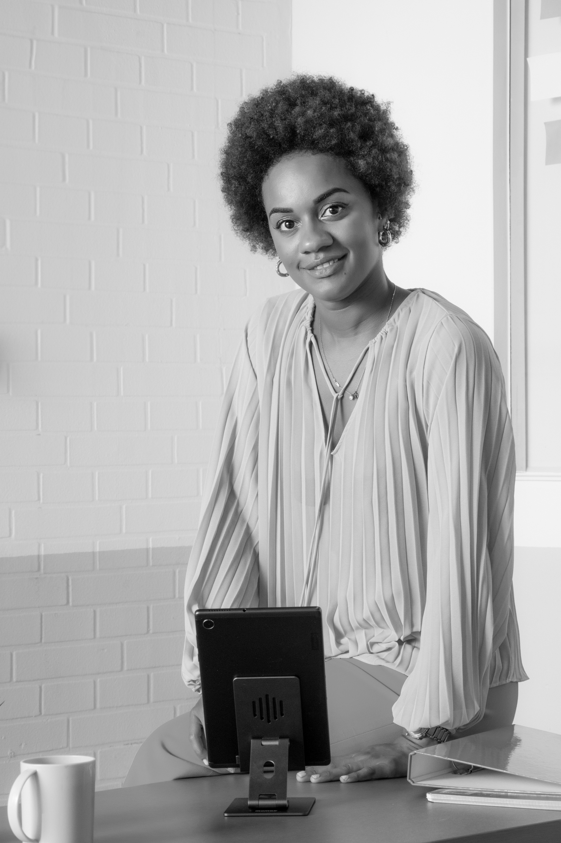
Introduction
01
We proudly announce that we will create an art exhibition this year featuring some of the popular artists in town.
For this year’s event, we aim to increase the number of visitors and provide a compelling art exhibition. We believe, together we can make this year’s event become one of the town's greatest art exhibitions.
ESTELLE DARCY
Head of Committee

Slide 4
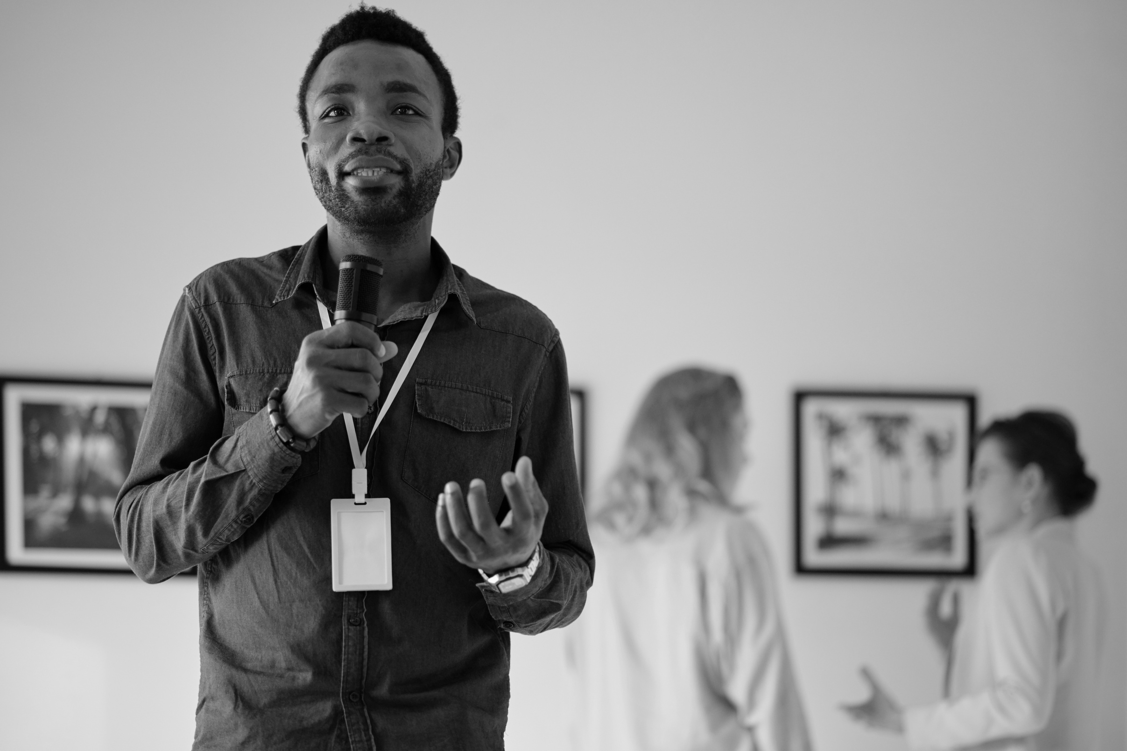
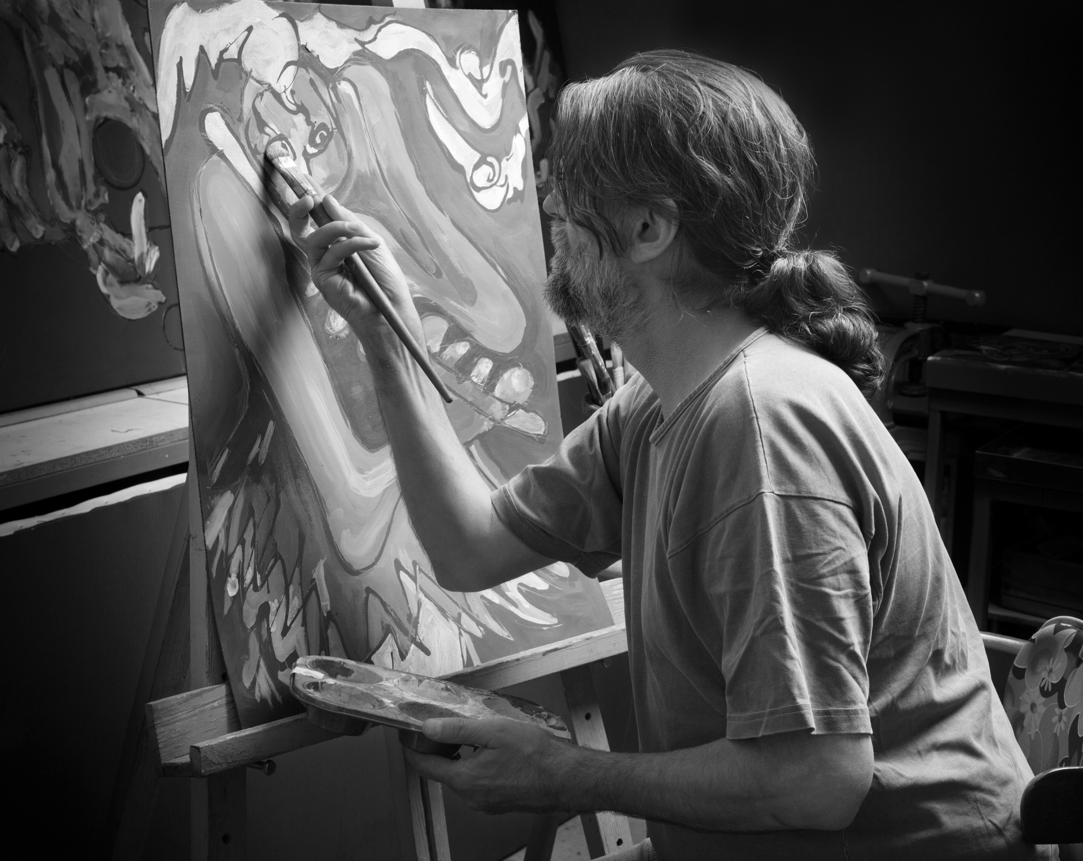
About the Event
02
The annual art exhibition from Borcelle has been held since 2001 to appreciate the great artwork of the talented local artists. All art enthusiasts gather to collaborate to make the event successfully held.
The enthusiasm of the audience and guests fuels our spirit to continue the annual event and make improvements in all aspects every year.

Slide 5
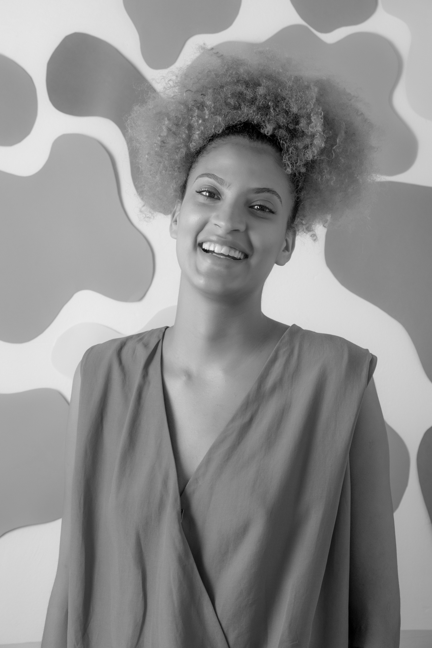


Event Committee
03
CLAUDIA ALVES
NDEMI OTIENO
EXECUTIVE DIRECTOR
NEIL TRAN
ARTIST LIAISON
EXHIBITION MANAGER

Slide 6
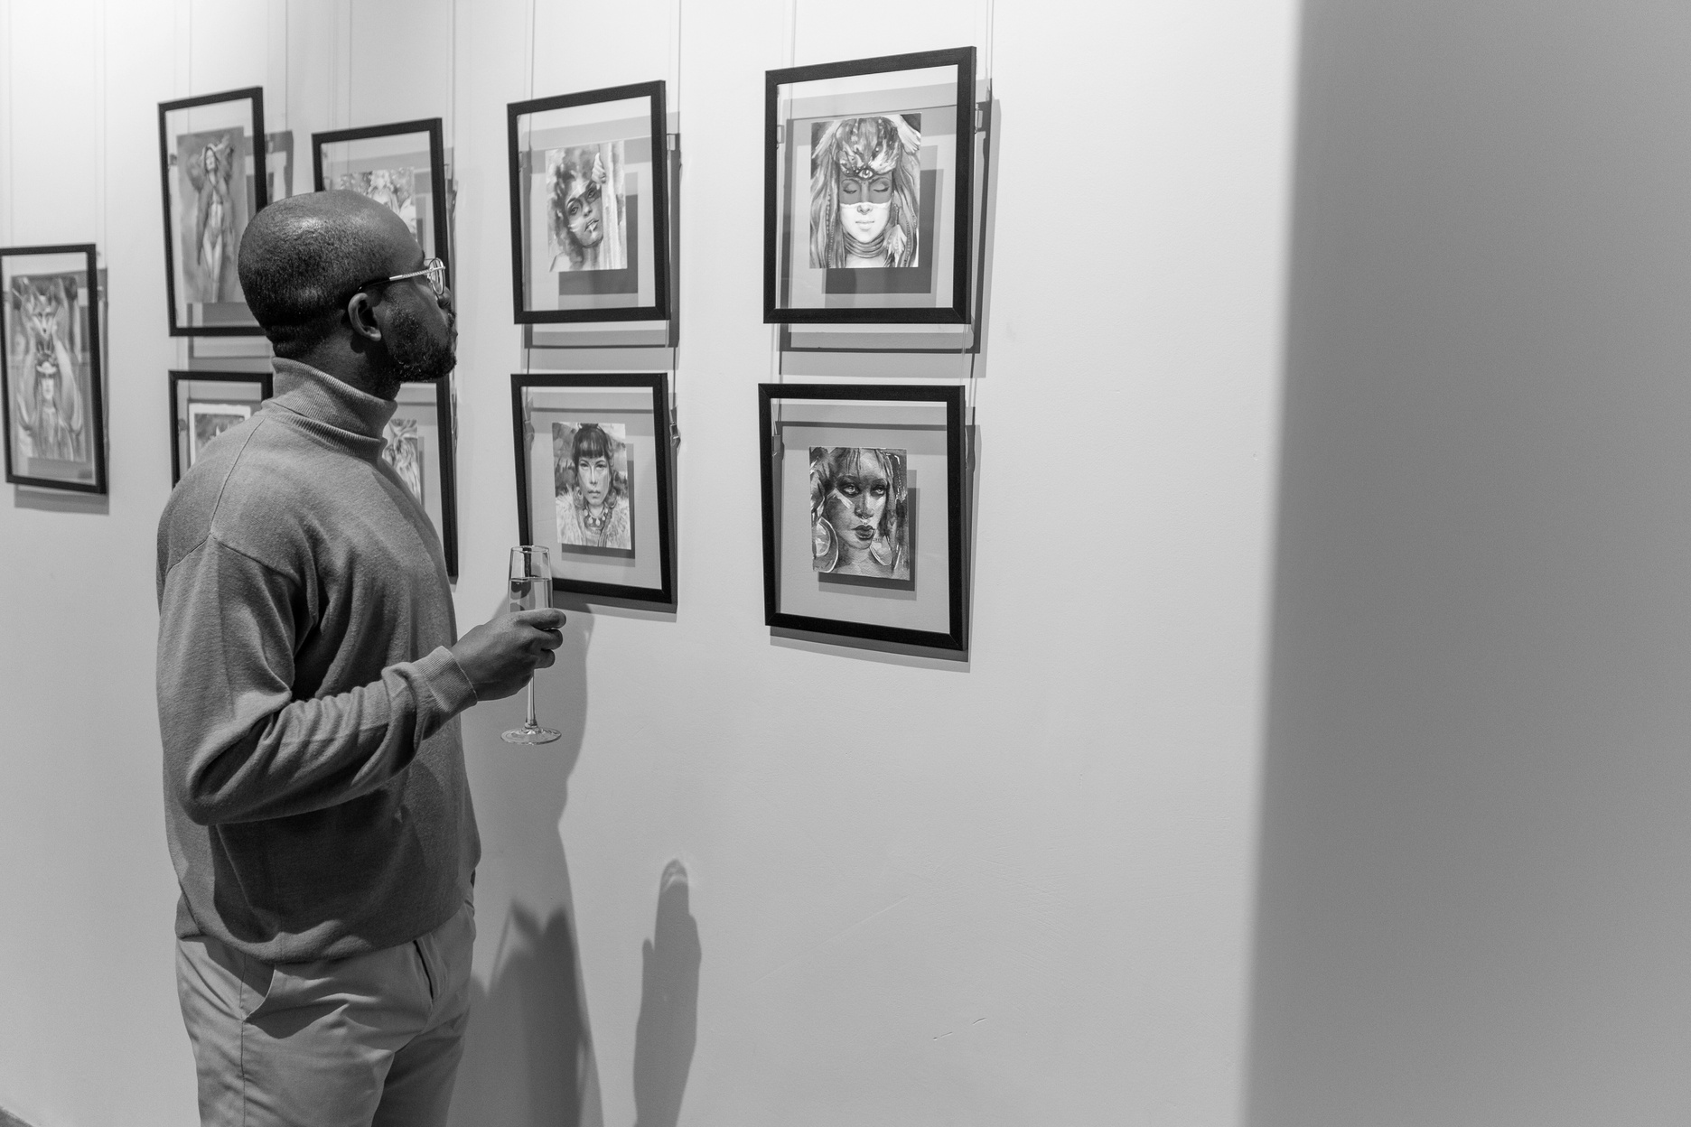
Event Activities
04
3 APRIL 2026
DAY 1
OPENING AND SHOWCASE THE ARTWORK FROM THE ARTISTS
4 APRIL 2026
DAY 2
ART AND PAINTING WORKSHOP
5 APRIL 2026
DAY 3
ART AUCTION AND CLOSING

Slide 7
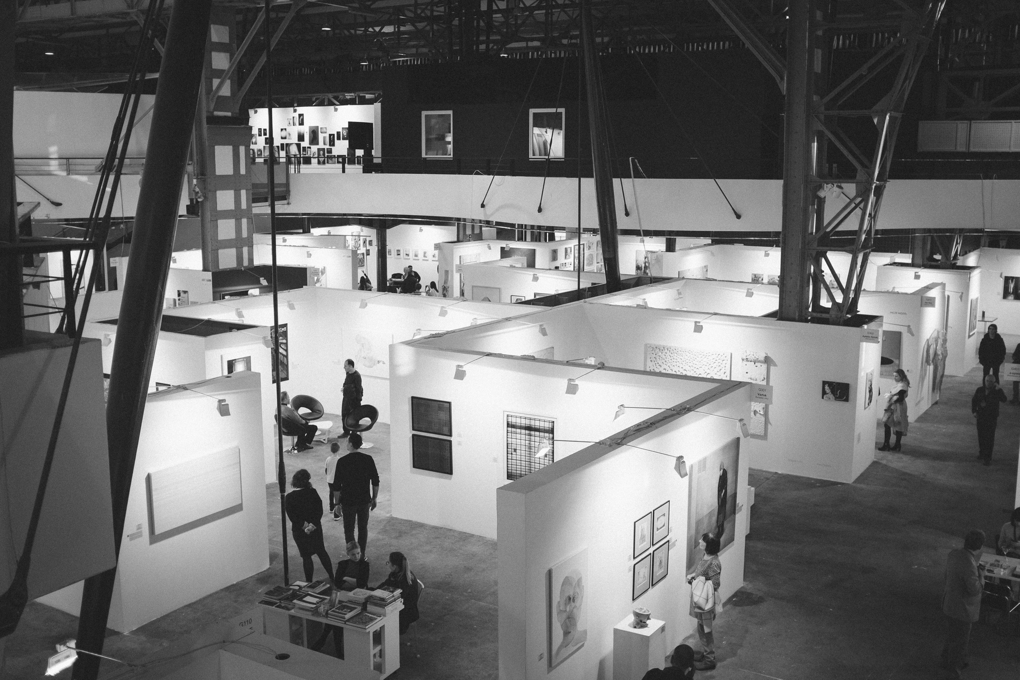
Event Venue
05
Hanover and Tyke Building will be the location for this year’s event.
Considering the large capacity and strategic location near the city center, we believe this building is the best venue for our event activities.
Hanover and Tyke Art Gallery
123 ANYWHERE ST., ANY CITY

Slide 8
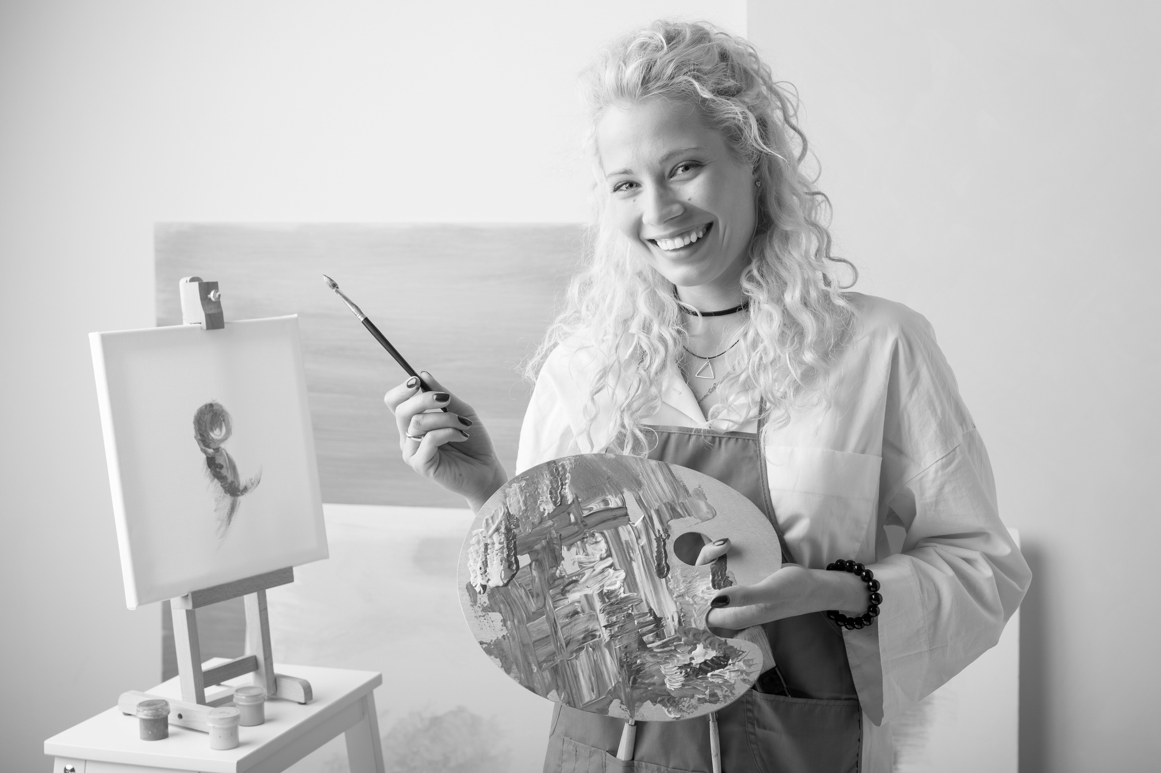
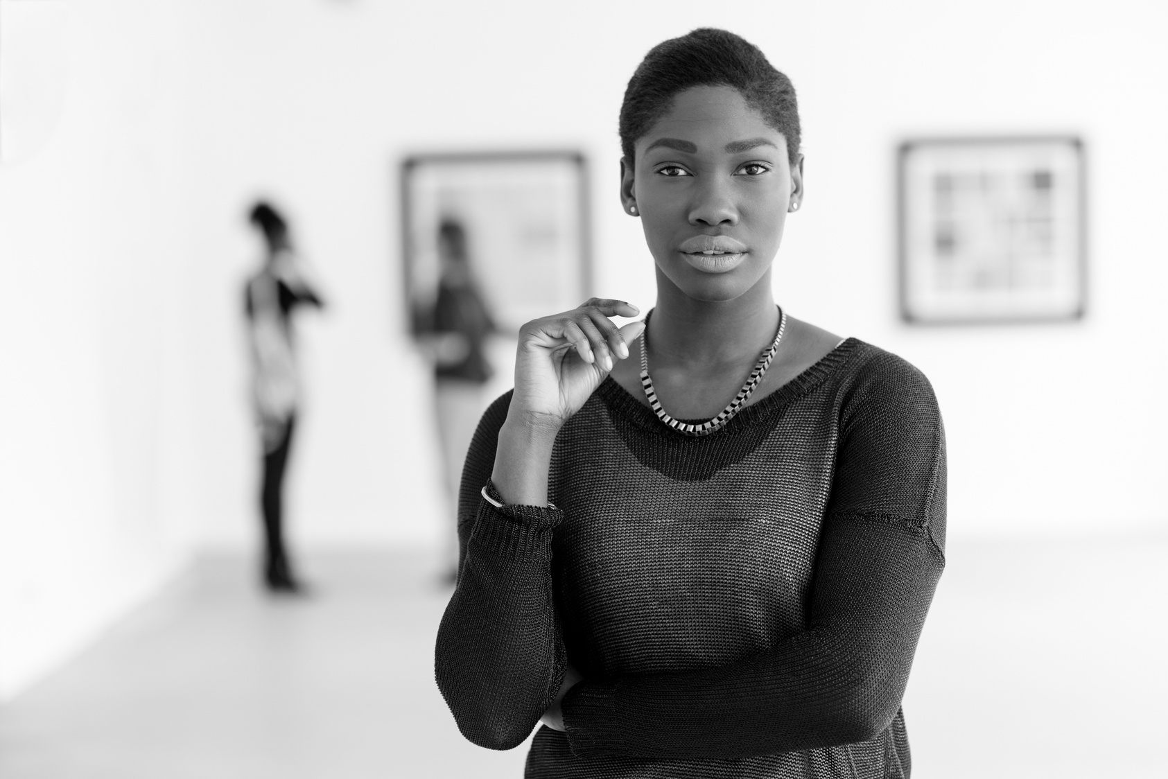
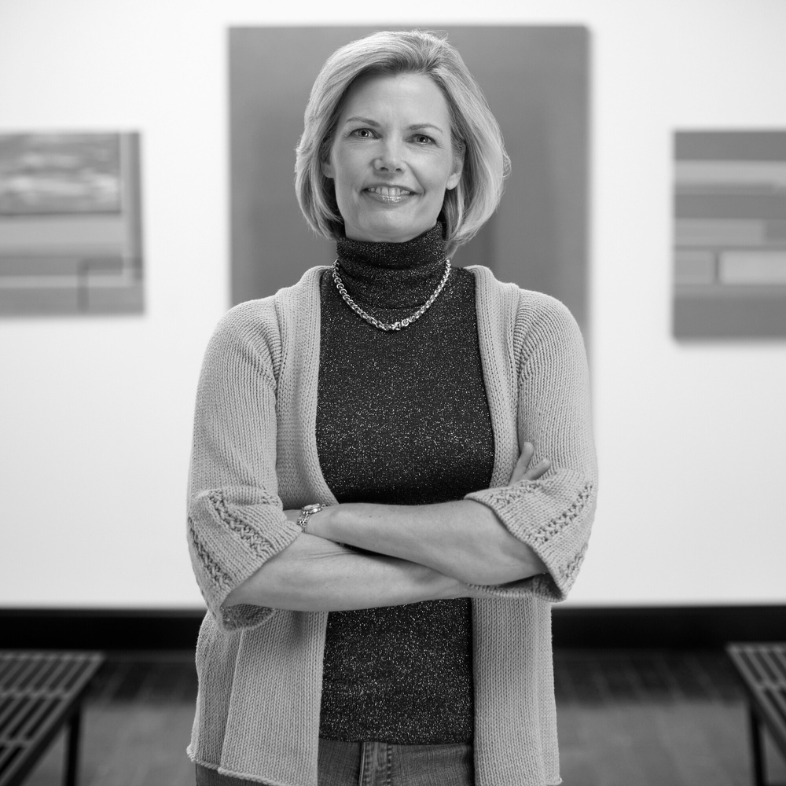
List of Artists
06
AVERY DAVIS
CHIDI EZE
JULIANA SILVA

Slide 9
Project Timeline
07
FIRST WEEK
THIRD WEEK
Survey and book
the venue
Sell the event ticket
SECOND WEEK
FOURTH WEEK
Design and print the event promotion kit
Get ready for the event

Slide 10


Let’s Make an Ama﻿zing Event Together!
2025
@reallygreatsite
www.reallygreatsite.com

